Slide 1


Information Extraction and Aggregation
from Unstructured Web Data
for Business Profiling
Student Team : Alexander Michels, Himanshu Ahuja, Liang Shi
Academic Mentor : Shadi Shahsavari
Industry Mentor : Dr. Stephen DeSalvo, Urjit Patel

Slide 2





Praedicat: An Insurance Tech Company
Determine litigation risks
Predict the likely amount of losses
1. Manual Search
2. Credible Database
3. Forward-looking Models
4. Predict Likely Losses
Notes:
Praedicat, Inc. is an InsurTech that is doing ground-breaking work in risk-analysis by modeling the state and evolution of scientific literature to characterize the risk. Their goal is to make the world cleaner, safer, and healthier by identifying the emerging risk using the methodology based on the peer-reviewed scientific literature. By mining peer-reviewed science journals they are able to anticipate tomorrow's claims.

Slide 3
Where do we fit in?
RIPS Team
Automating
1. Manual Search
2. Credible Database
3. Forward-looking Models
4. Predict Likely Losses
Notes:
Praedicat, Inc. is an InsurTech that is doing ground-breaking work in risk-analysis by modeling the state and evolution of scientific literature to characterize the risk. Their goal is to make the world cleaner, safer, and healthier by identifying the emerging risk using the methodology based on the peer-reviewed scientific literature. By mining peer-reviewed science journals they are able to anticipate tomorrow's claims.

Slide 4

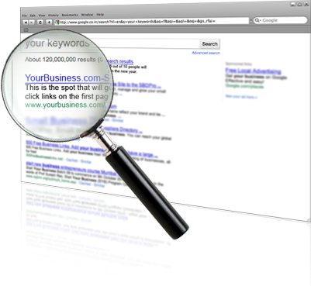

Manual Search Process
1. Search Engine
Change
Keywords
2. Site Search
3. Evaluate Contents

Slide 5
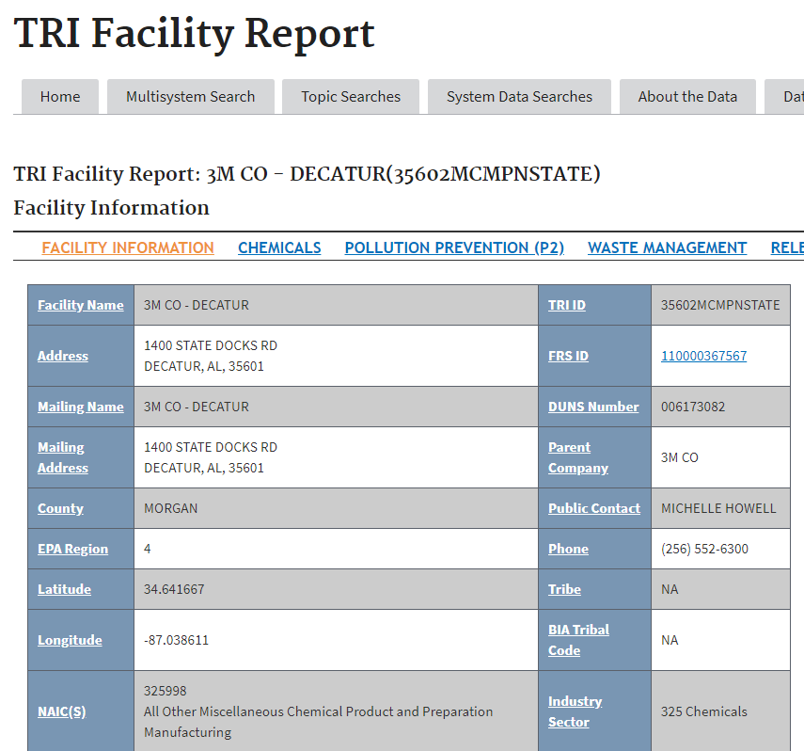
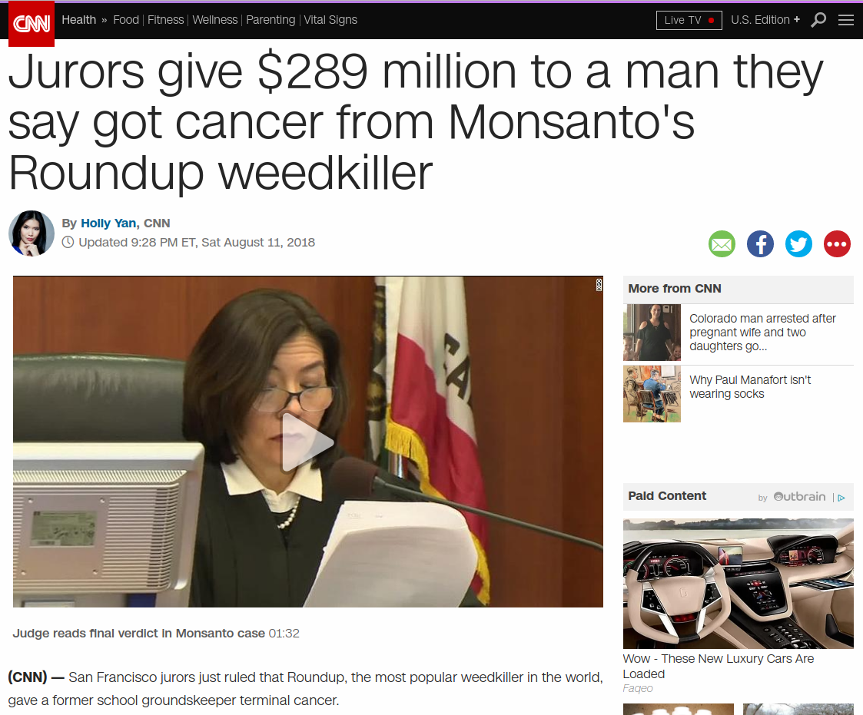
Difficulty of Searching Information
Less Indicative of Litigation Risks
More Indicative of Litigation Risks
- Government Databases
- News

Slide 6
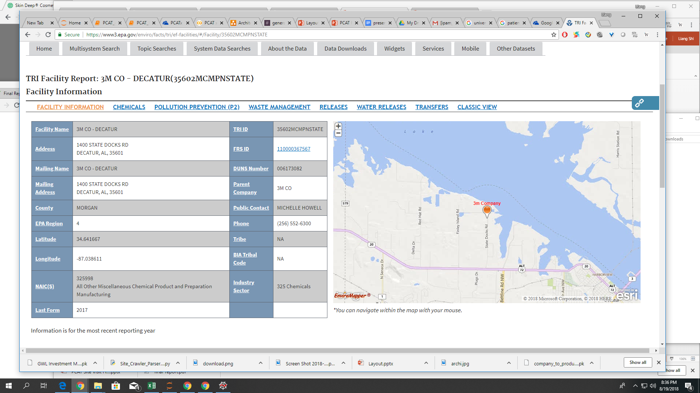
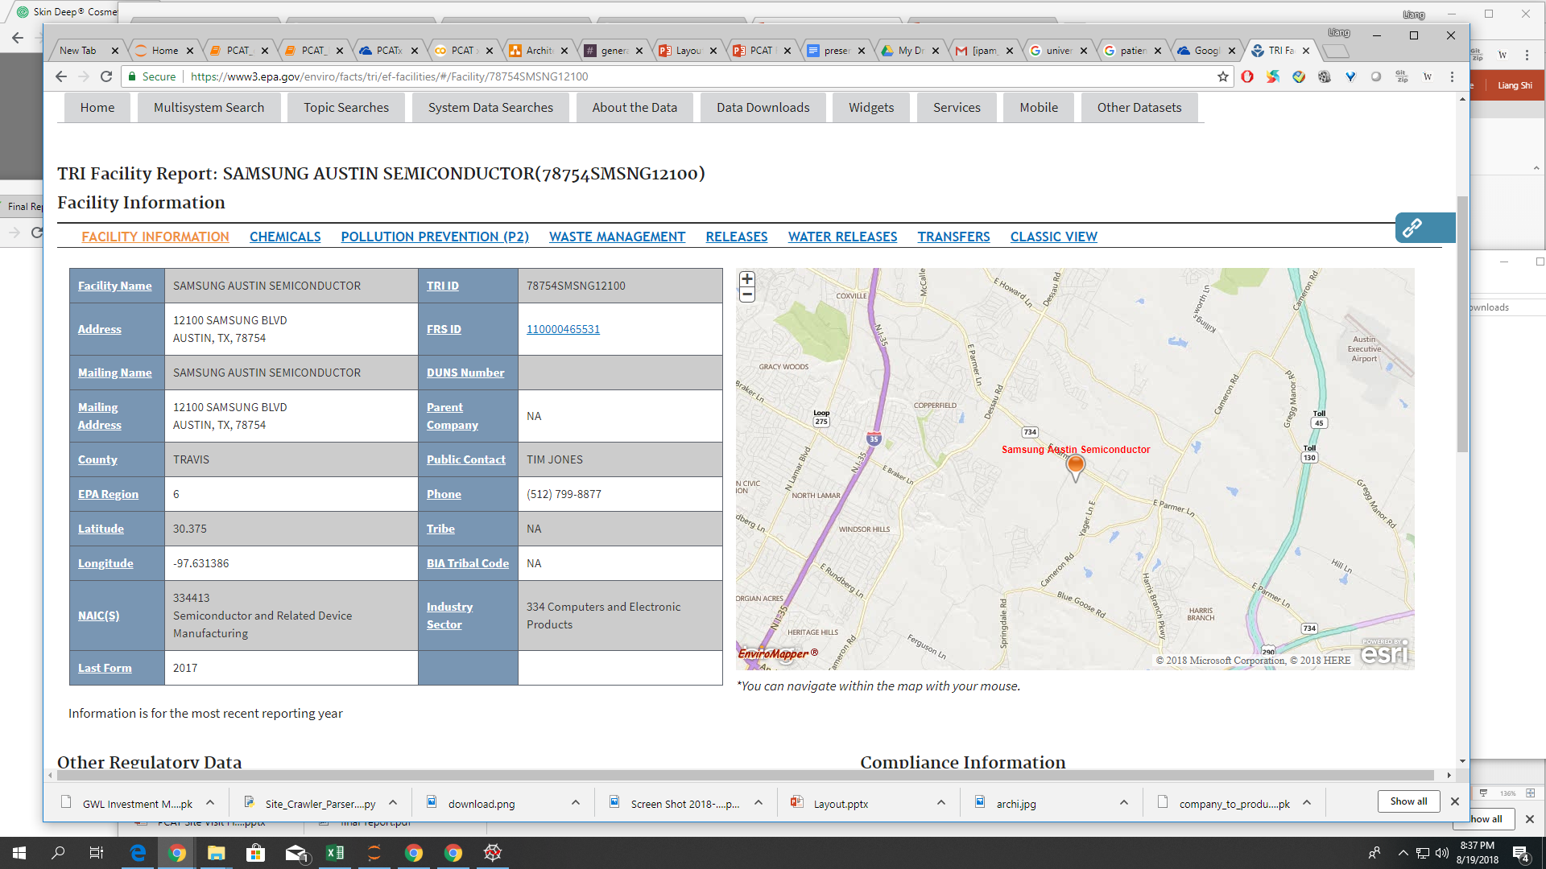
Structured Web Pages
Facility Report for 3M
Facility Report for Samsung

Slide 7
Structured Web Pages
Facility Report for 3M
Facility Report for Samsung

Slide 8
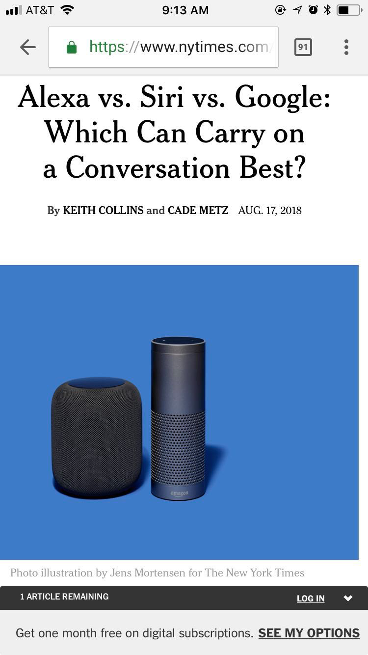
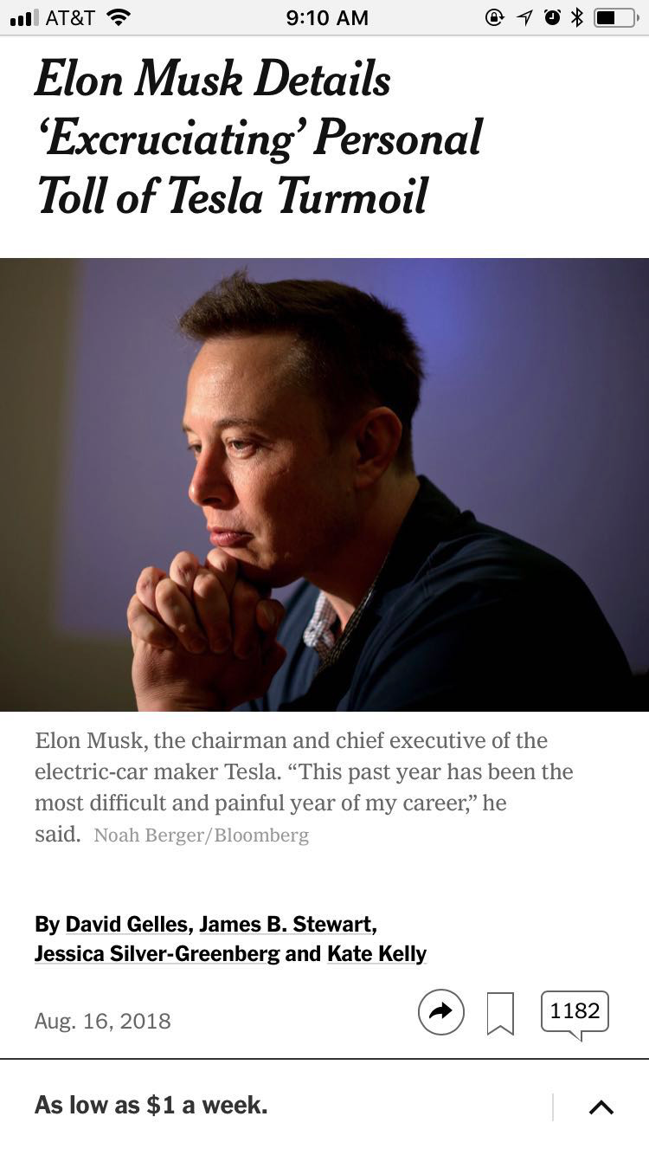
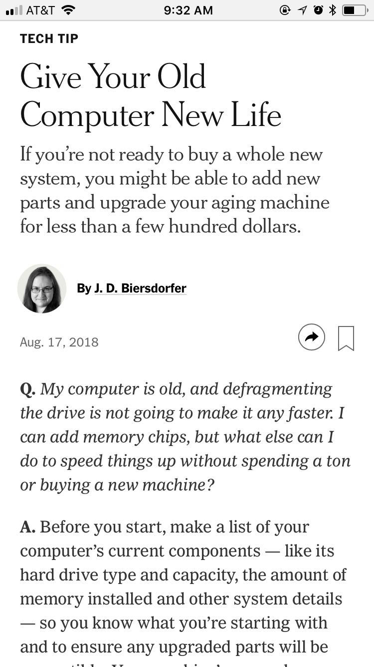
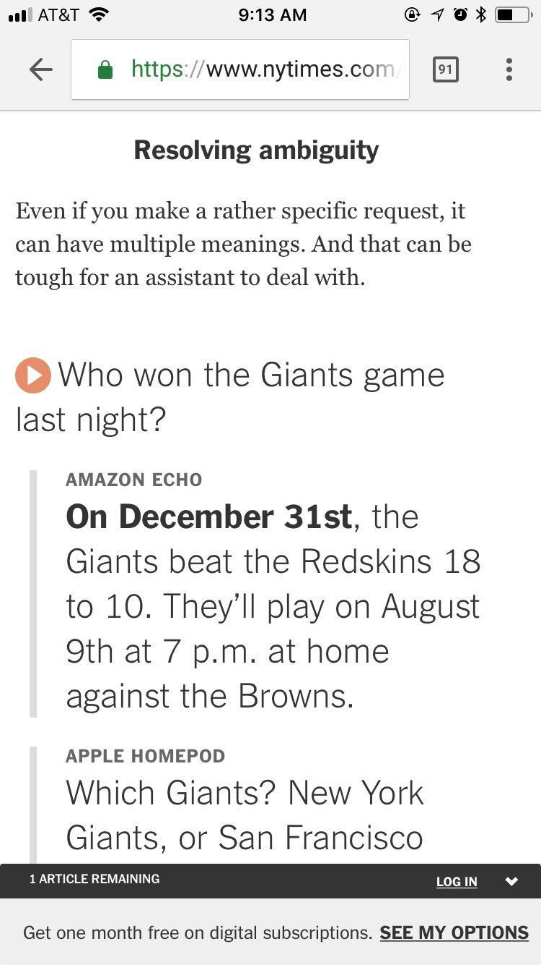
Unstructured Web Pages

Slide 9
Unstructured Web Pages

Slide 10
Problem Statement
How to automate information extraction, classification, and fact-checking for unstructured data on the Internet
Notes:
Right now their assessment of risk is based on proprietary algorithms that extract information on business practices and chemicals from over 10,000 peer-reviewed journals and from regulatory documents, but there is a lot more information out there. There are news articles and tons of other documents freely available on the internet, but of course the problem is that unlike the peer-reviewed journals Praedicat generally works with, the data on the web is generally unstructured, the credibility is questionable, and the conclusions are a bit harder to draw. In a broad sense, we are helping Praedicat first find relevant information on the web by building a web crawler, and from there we need to use Natural Language Processing to process the data with the hopes we can come up with data that is useable for the Praedicat models.

Slide 11
Solution Overview
Web Crawling Framework
Information Classification & Aggregation
Computational Fact-Checking using KGs

Slide 12

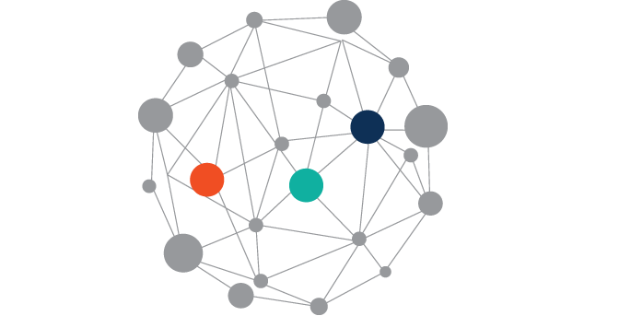
Web Crawling Framework
Query Formulator
“3M”
Mandatory
Raw text
~Minnesota ~Mining
~Manufacturing
Company
Name
Optionals
filetype:PDF
Information Classification & Aggregation
Master
Document
Computational Fact-Checking using KGs
Base Knowledge Graph

Slide 13
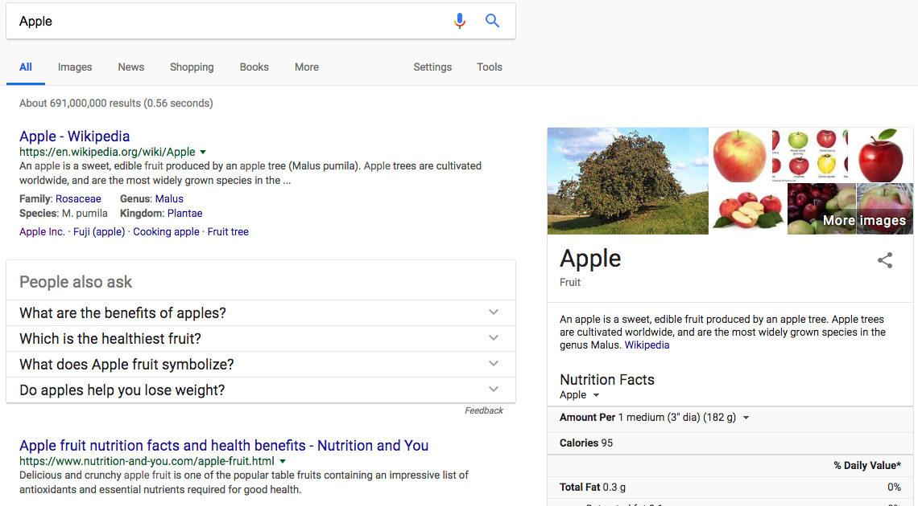
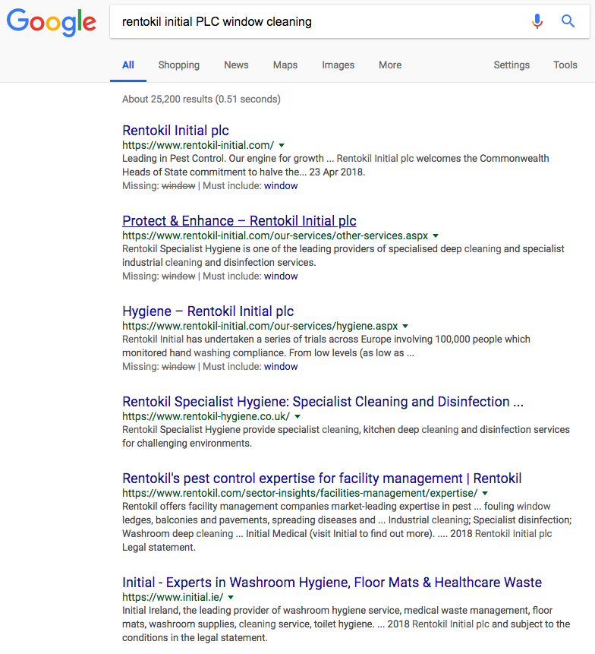
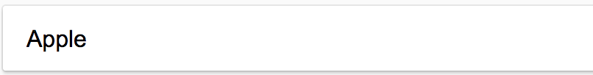
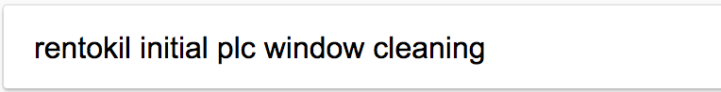
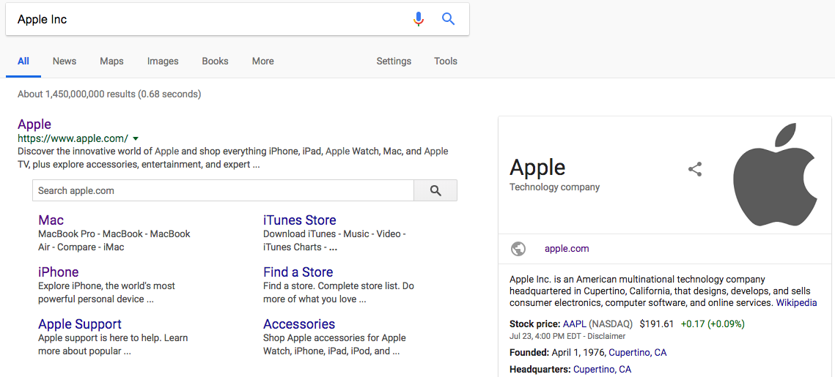
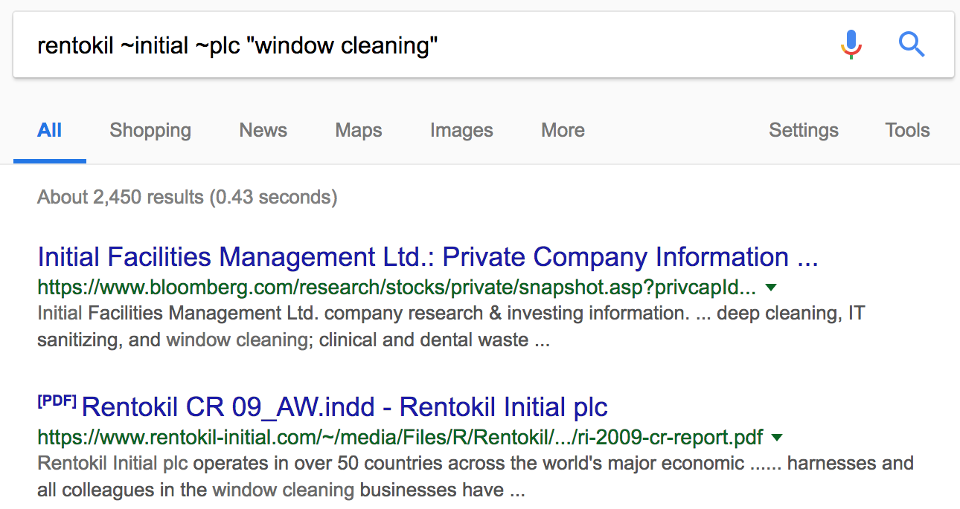
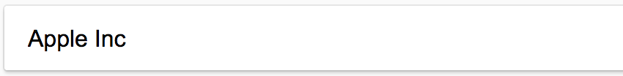

Query Formulator: Asking about the right things!
Zero useful results
‘Apple Inc.’ returns the right results.
PDF result mentions Rentokil Initial PLC involvement in window cleaning.

Slide 14
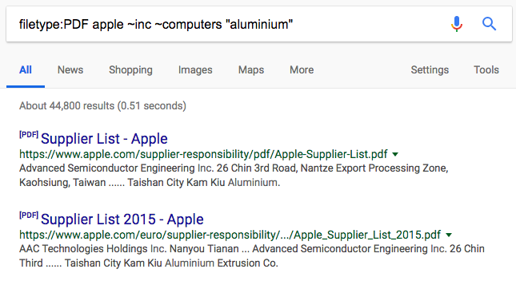
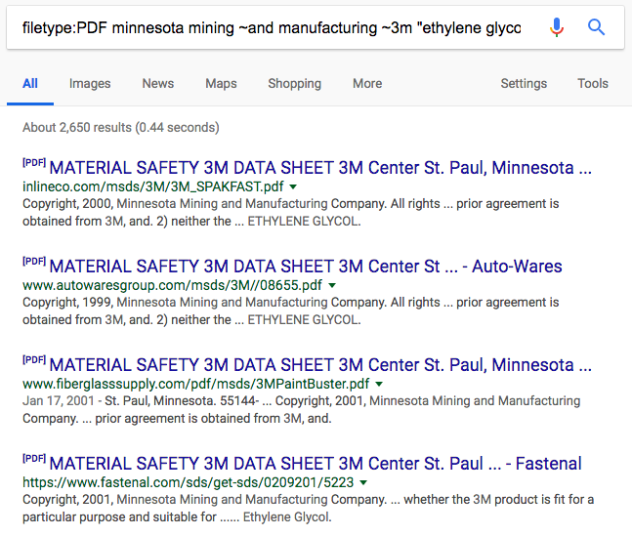
Query Formulator: How did we ask the right things?
Making some words optional
Mention the file-type
Making keywords mandatory
Name of the company
Optional alias

Slide 15
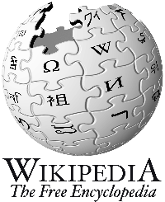



Web Crawling Framework
Query Formulator
Web Crawler
Refined
Query
“3M”
Mandatory
Raw text
~Minnesota ~Mining
~Manufacturing
Company
Name
Optionals
filetype:PDF
Information Classification & Aggregation
Master
Document
Computational Fact-Checking using KGs
Base Knowledge Graph

Slide 16
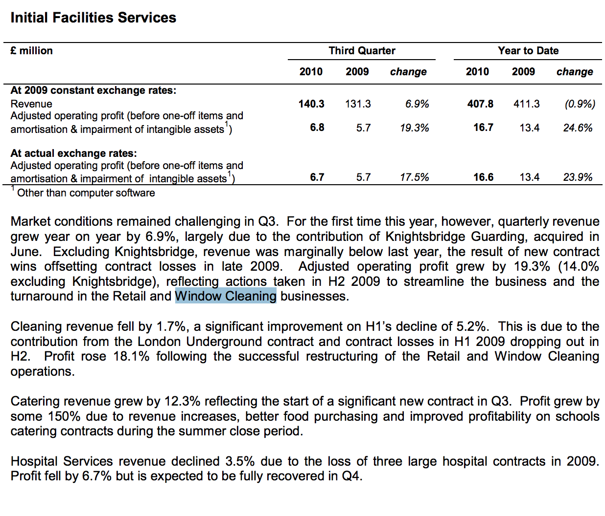

Web Crawling: What is web Crawling?
Start
End
Notes:
SCRAPING IN A WAY, THAT WE GET TO THE DESIRED WEBSITE.

Slide 17
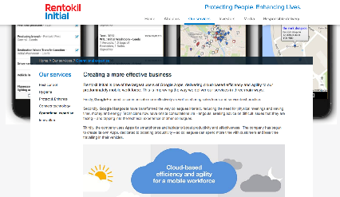
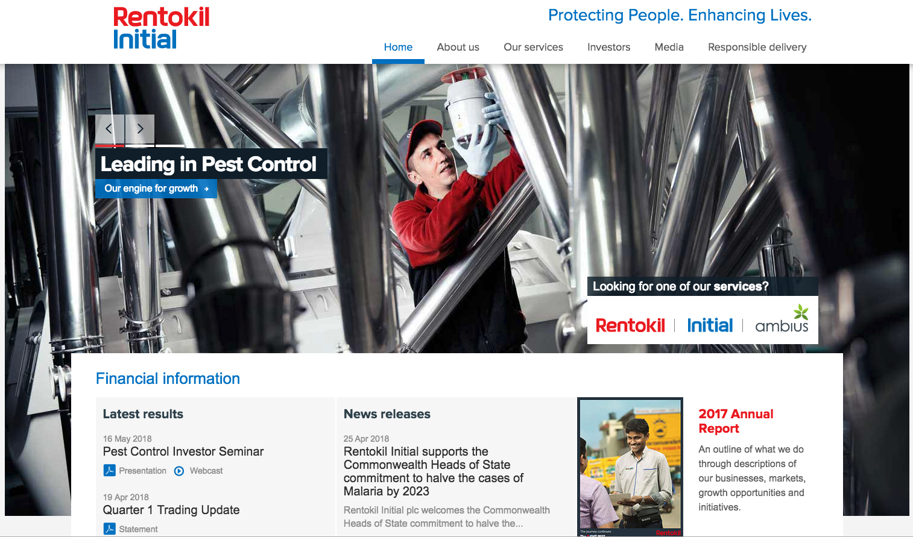
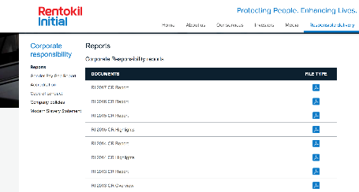
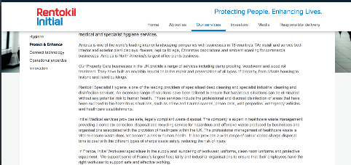
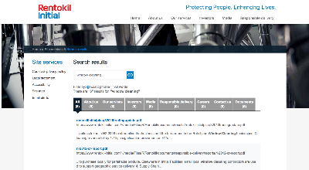
Web Crawling: Unsupervised machines cannot be trusted
End
Start
The business activity appears in the financial report that specifically appears on search services provided by the website.
Start with a google search of the company and its business activity.
Notes:
SCRAPING IN A WAY, THAT WE GET TO THE DESIRED WEBSITE.

Slide 18
Web Crawling: Where and how far?
The problem:
We don’t know how far to dig, and where to dig?
We don’t know the credible sources and where the information lies on the credible sources.

Slide 19
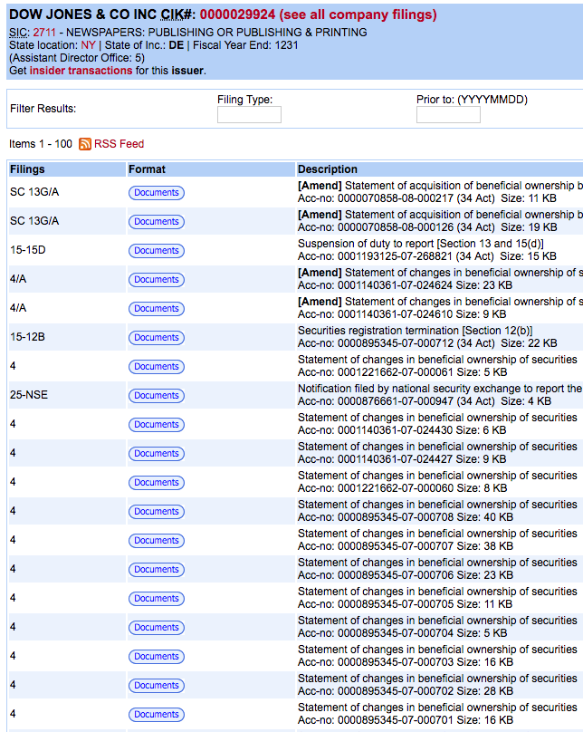
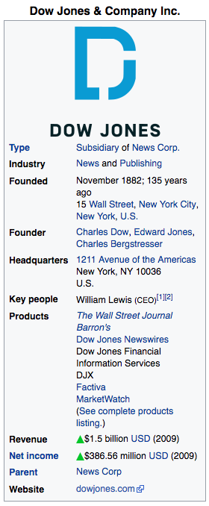
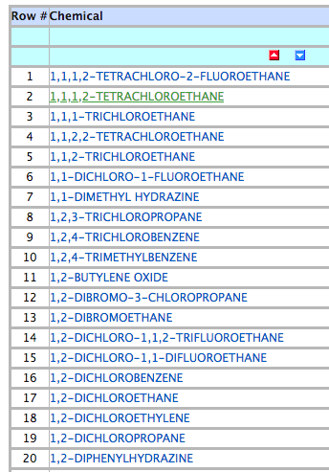
Web Crawling: Credible data to the rescue
Interestingly, the structured data (available on Federal websites & Wikipedia) is also credible!
Designed specific crawlers to get data from specific databases.
Created a baseline data to support unsupervised web crawling.

Slide 20
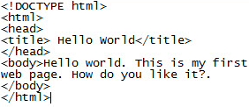
Web Crawling Framework
Query Formulator
Web Crawler
Parser
Refined
Query
List of
URLs
“3M”
Mandatory
Raw text
~Minnesota ~Mining
~Manufacturing
Company
Name
Optionals
filetype:PDF
Information Classification & Aggregation
Master
Document
Computational Fact-Checking using KGs
Base Knowledge Graph

Slide 21
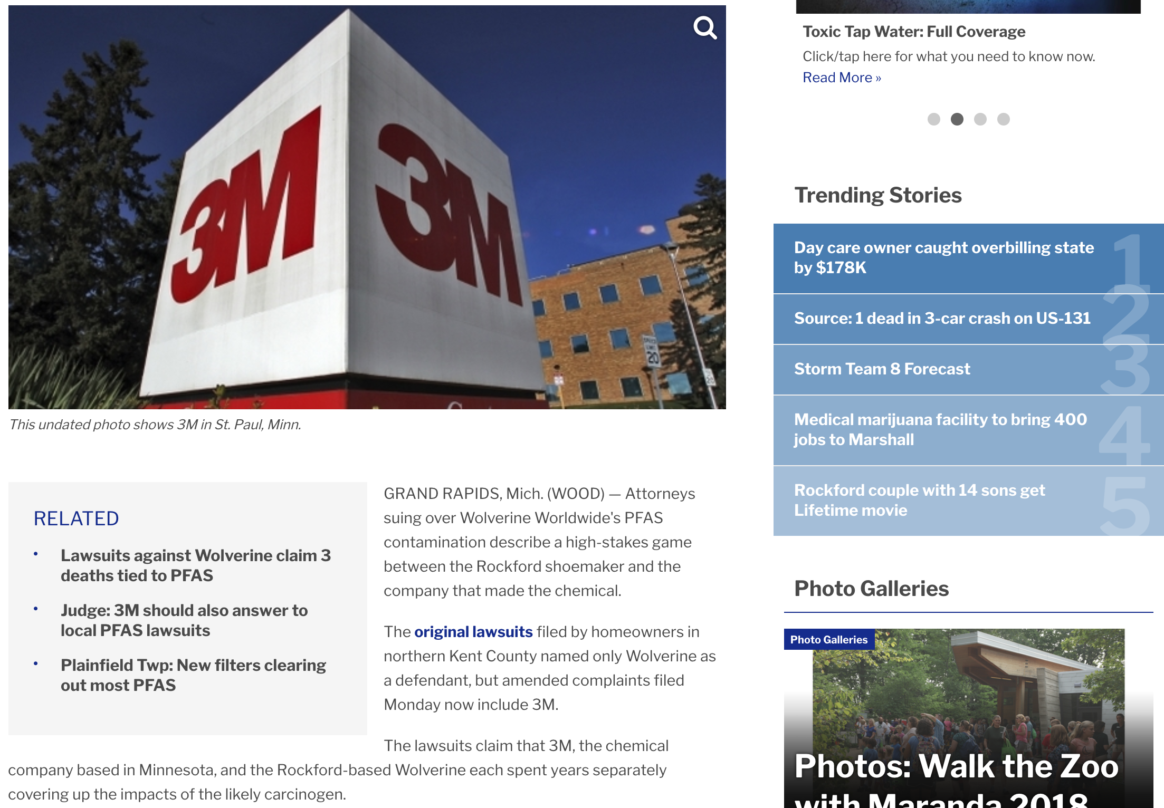
Parser:
Getting unstructured data
Use of text abundance to locate meaningful paragraphs.
Filtering out tags containing social media redirects.
Removing graphic contents, advertisements.

Slide 22



Web Crawling Framework
Query Formulator
Web Crawler
Parser
Web Resource Manager
Refined
Query
List of
URLs
Raw
Texts
“3M”
Mandatory
Raw text
~Minnesota ~Mining
~Manufacturing
Company
Name
Optionals
filetype:PDF
SEC
Source
URLs
…
Information Classification & Aggregation
Master
Document
Computational Fact-Checking using KGs
Base Knowledge Graph

Slide 23



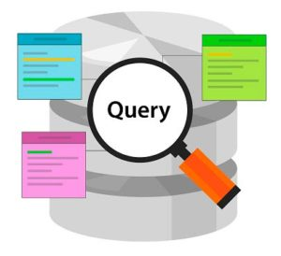



Web Resource Manager:
source/resource_uuid.(pdf/html)
docs/resource_uuid.json
UUID(Universally Unique Identifier)

Slide 24
Web Crawling Framework
The 3M Company, formerly known as the Minnesota Mining and Manufacturing Company, is an American multinational conglomerate corporation operating in the fields of industry, health care, and consumer goods.^{[2]} The company produces a variety of products, including adhesives, abrasives, laminates, passive fire protection, personal protective equipment, dental and orthodontic products, electronic materials, medical products, car-care products,^{[3]} electronic circuits, healthcare software and optical films.^{[4]}
Query Formulator
Web Crawler
Parser
Web Resource Manager
Output
Refined
Query
List of
URLs
Raw
Texts
“3M”
Mandatory
~Minnesota ~Mining
~Manufacturing
Company
Name
Optionals
filetype:PDF
SEC
Source
URLs
…
Raw text
Information Classification & Aggregation
Master
Document
Computational Fact-Checking using KGs
Base Knowledge Graph

Slide 25
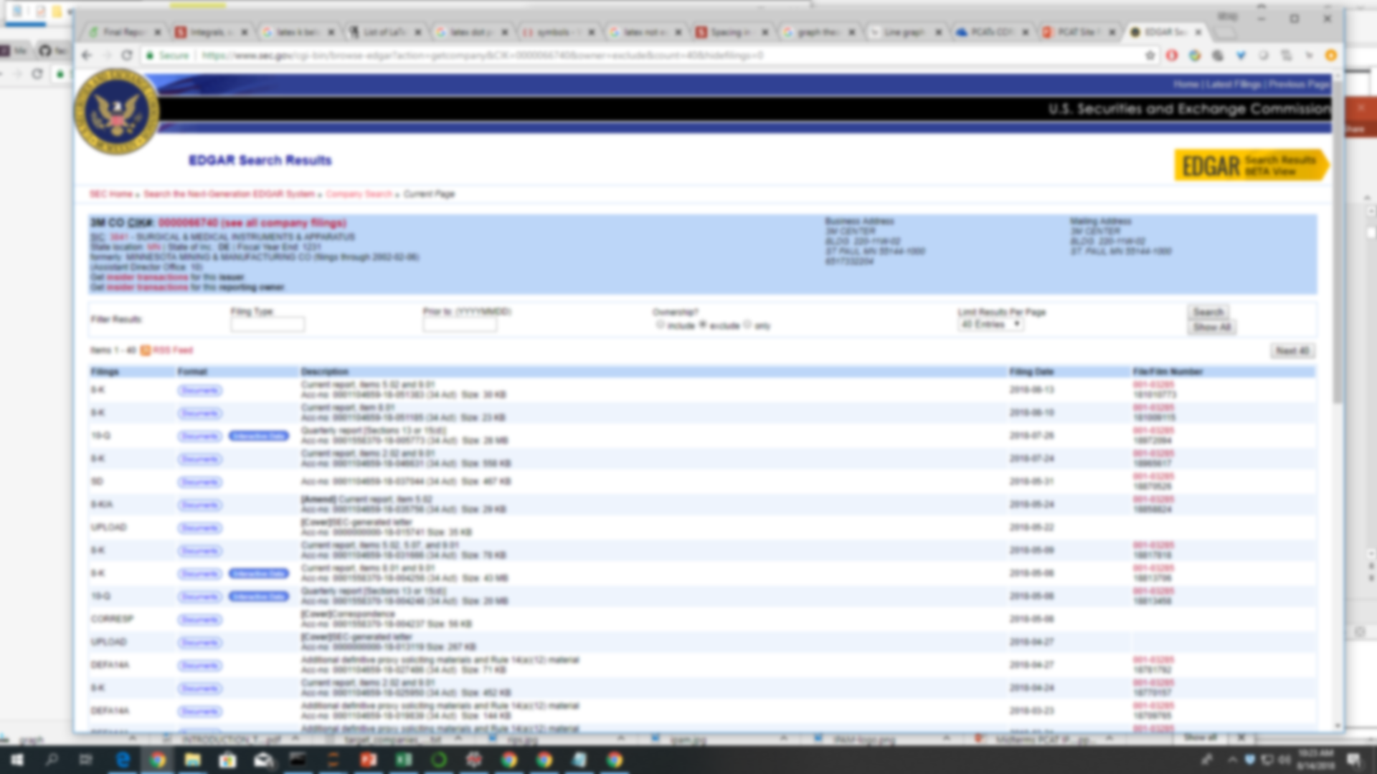
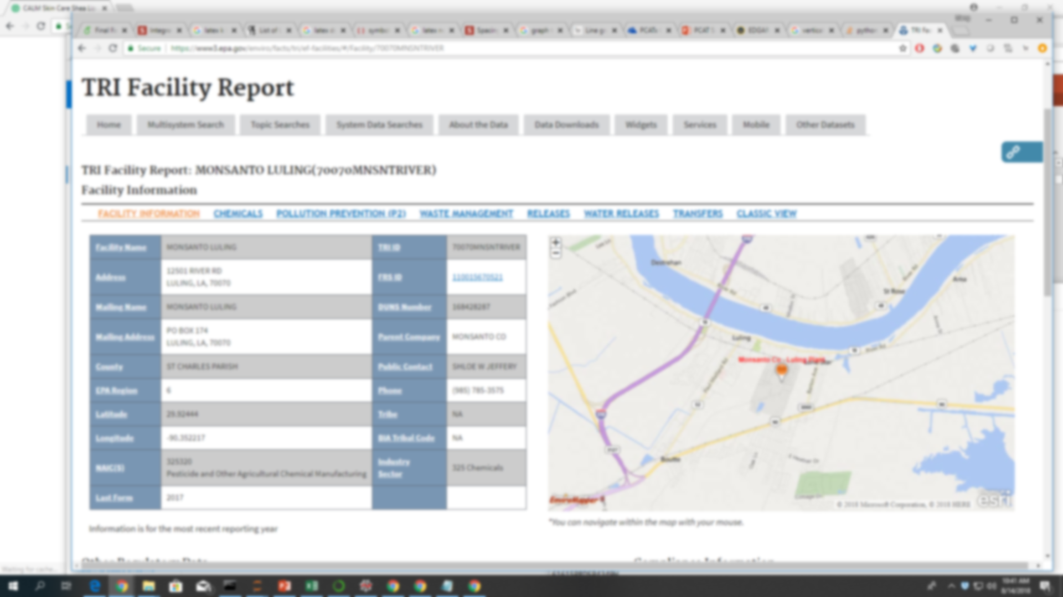
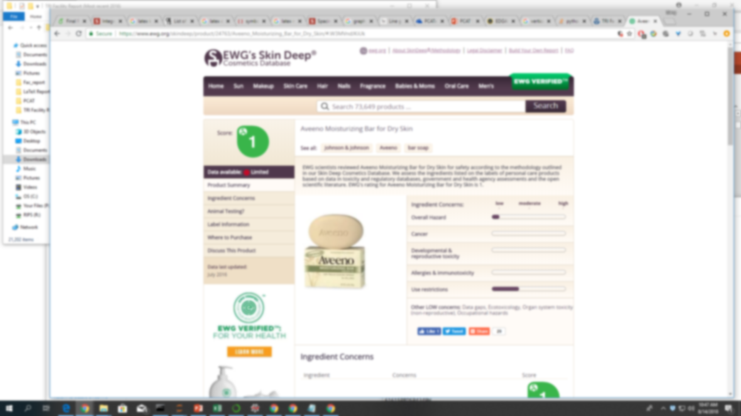
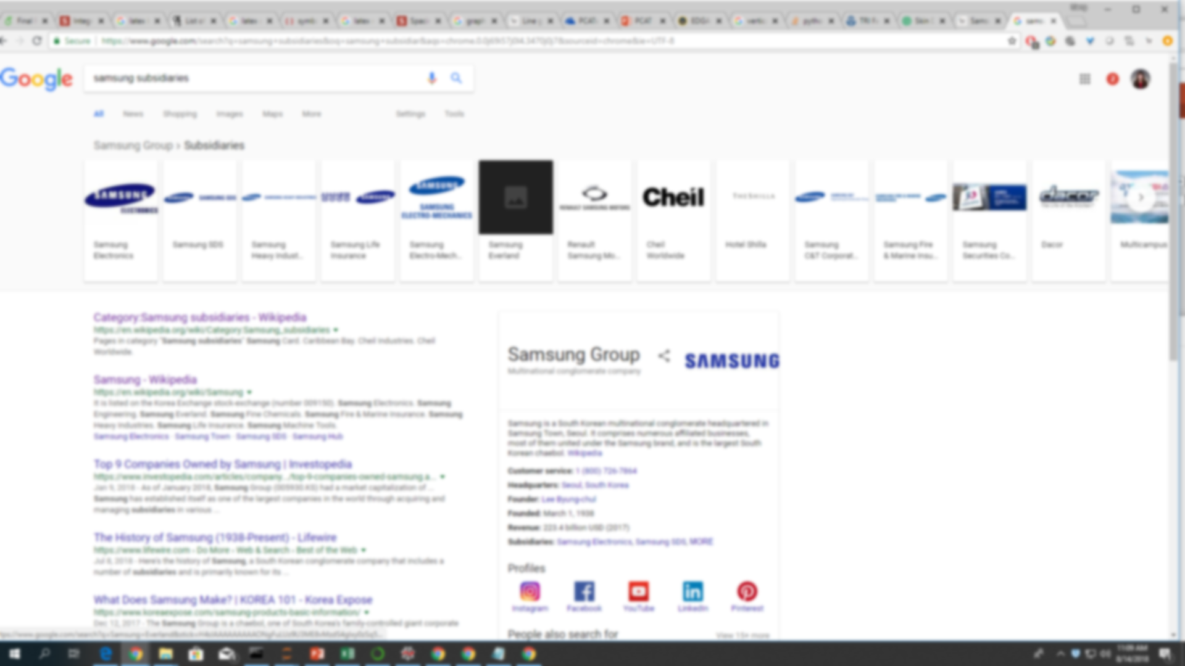
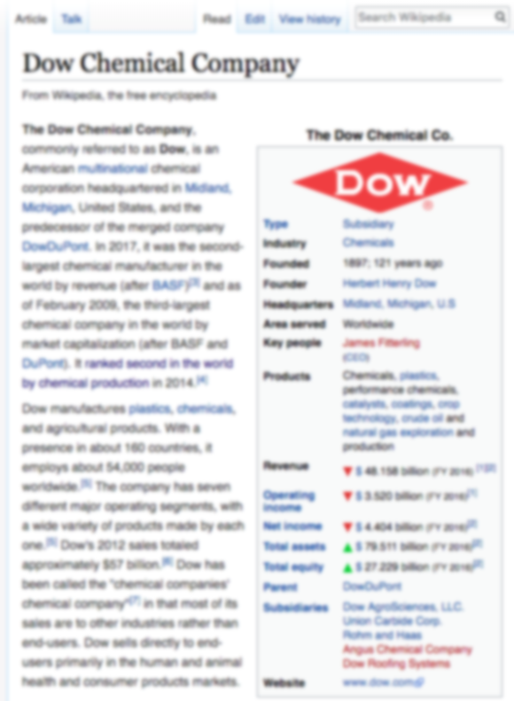
Outputs of Site Crawlers
Data
Financial statements for 52,629 companies
21,202 Facility Reports
Product and ingredient list for 4,535 companies
Thousands of subsidiary structures
Tens of thousands of Wikipedia pages

Slide 26
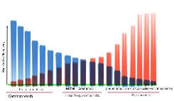
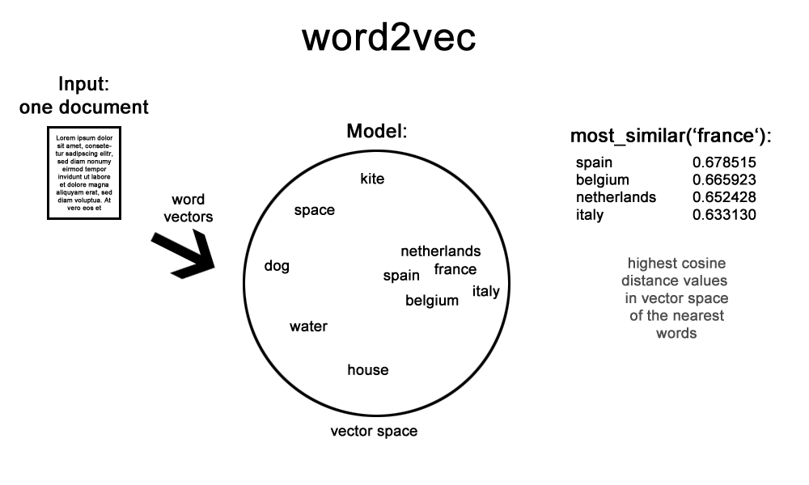
Web Crawling Framework
The 3M Company, formerly known as the Minnesota Mining and Manufacturing Company, is an American multinational conglomerate corporation operating in the fields of industry, health care, and consumer goods.^{[2]} The company produces a variety of products, including adhesives, abrasives, laminates, passive fire protection, personal protective equipment, dental and orthodontic products, electronic materials, medical products, car-care products,^{[3]} electronic circuits, healthcare software and optical films.^{[4]}
Query Formulator
Web Crawler
Parser
Web Resource Manager
Output
Refined
Query
List of
URLs
Raw
Texts
“3M”
Mandatory
~Minnesota ~Mining
~Manufacturing
Company
Name
Optionals
filetype:PDF
SEC
Source
URLs
…
Raw text
Information Classification & Aggregation
Classifier
Master
Document
Computational Fact-Checking using KGs
Base Knowledge Graph

Slide 27
Label
Train Classifier
Use Classifier
Self-Supervised Learning
Labels its own training examples using heuristics
Trains a classifier on the examples it labeled
Classifies using the features it learned from self-labeled data

Slide 28
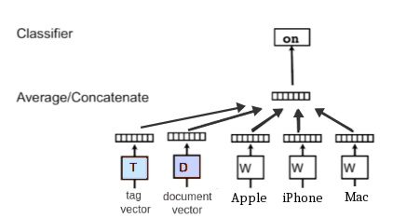
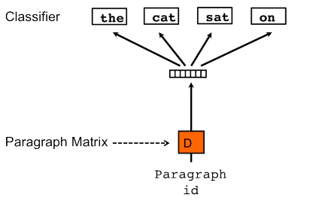
Doc2Vec
Represents semantic meaning of documents in a vector space
You can "tag" documents with topics.
We can attempt to cluster or classify documents using tags.
Apple
iPhone
Swift
Mac

Slide 29
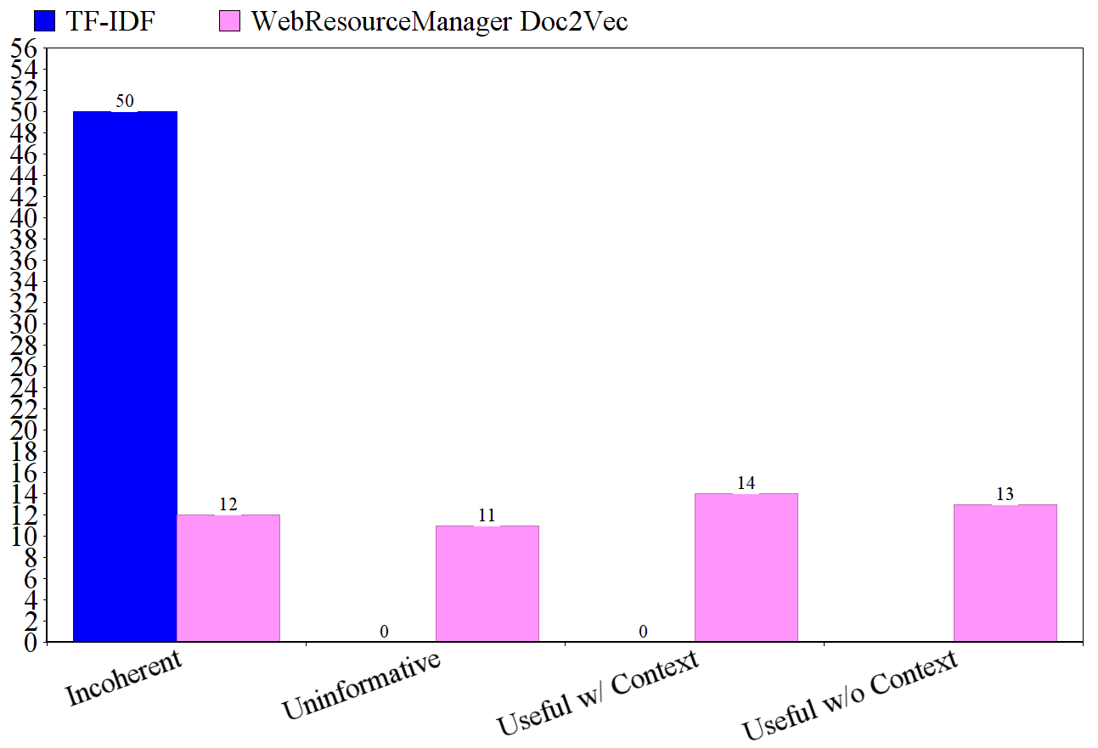
Classification Results: Web Pages
TF-IDF Produced:
- riddel j
1941
rhop
danaida
- boisduv j
We Produced:
2014 Chemr acquired 3D-Radar as a subsidiary of Curtiss-Wright Corporation in May 2014

Slide 30
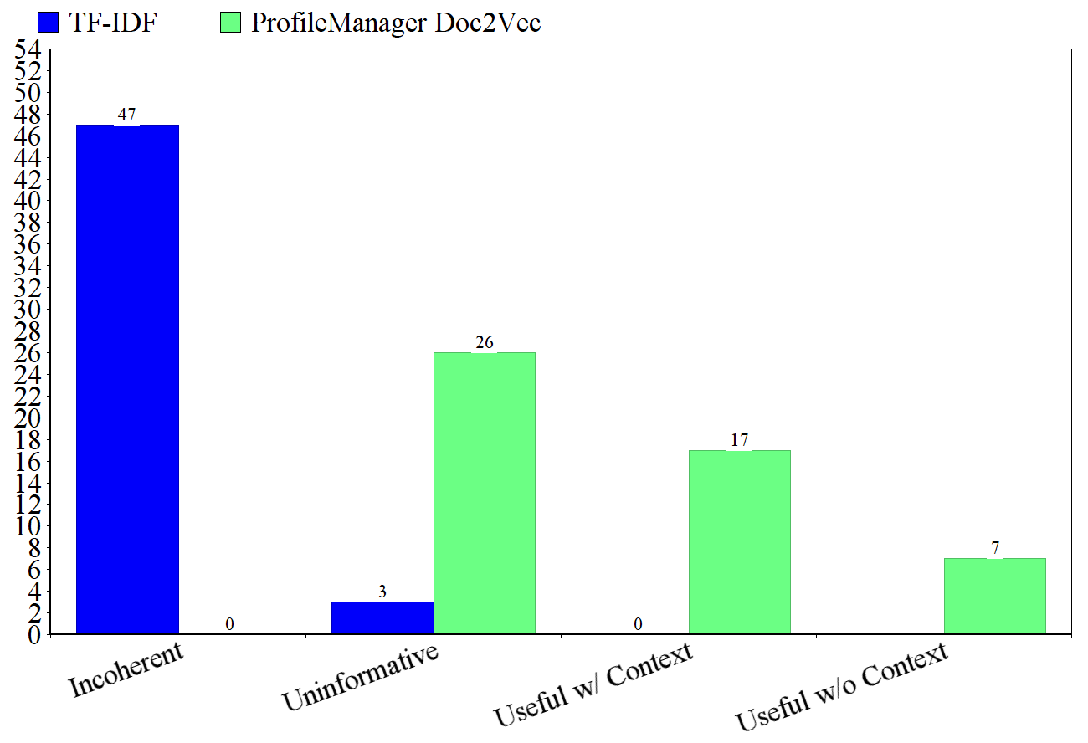
Classification Results: Financial Statements
TF-IDF Produced:
item 3
asu no
see note 2
10
-11
We Produced:
these challenges add to the uncertainties of the legislative changes enacted as part of ACA

Slide 31
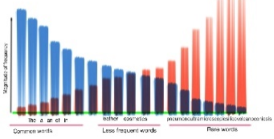
Web Crawling Framework
The 3M Company, formerly known as the Minnesota Mining and Manufacturing Company, is an American multinational conglomerate corporation operating in the fields of industry, health care, and consumer goods.^{[2]} The company produces a variety of products, including adhesives, abrasives, laminates, passive fire protection, personal protective equipment, dental and orthodontic products, electronic materials, medical products, car-care products,^{[3]} electronic circuits, healthcare software and optical films.^{[4]}
Query Formulator
Web Crawler
Parser
Web Resource Manager
Output
Refined
Query
List of
URLs
Raw
Texts
“3M”
Mandatory
~Minnesota ~Mining
~Manufacturing
Company
Name
Optionals
filetype:PDF
SEC
Source
URLs
…
Raw text
Information Classification & Aggregation
Profile Manager
Classifier
CIK → SEC NAICS → SEC
SEC → CIK
Master
Document
Pfizer
URLs
3M
Wiki
Relevant Text Documents
Dole
Subsidiaries
Computational Fact-Checking using KGs
Base Knowledge Graph

Slide 32

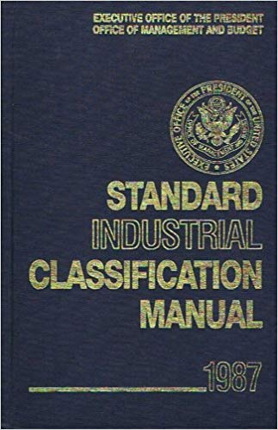

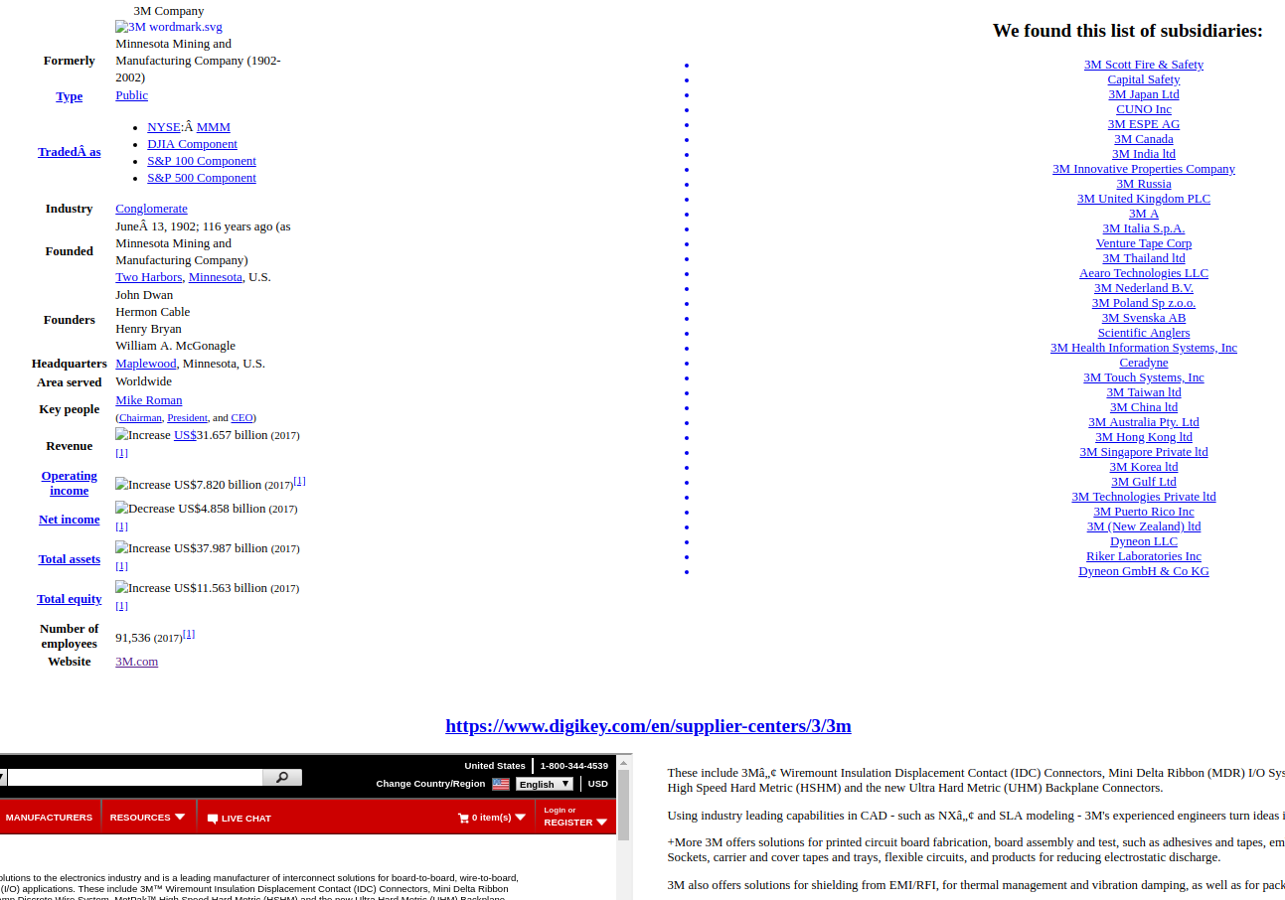
Profile Manager
Central Index Key
Aggregates information by company
Queryable
Contains utility functions

Slide 33
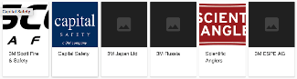
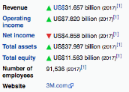
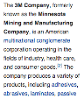
Web Crawling Framework
The 3M Company, formerly known as the Minnesota Mining and Manufacturing Company, is an American multinational conglomerate corporation operating in the fields of industry, health care, and consumer goods.^{[2]} The company produces a variety of products, including adhesives, abrasives, laminates, passive fire protection, personal protective equipment, dental and orthodontic products, electronic materials, medical products, car-care products,^{[3]} electronic circuits, healthcare software and optical films.^{[4]}
Query Formulator
Web Crawler
Parser
Web Resource Manager
Output
Refined
Query
List of
URLs
Raw
Texts
“3M”
Mandatory
~Minnesota ~Mining
~Manufacturing
Company
Name
Optionals
filetype:PDF
SEC
Source
URLs
…
Raw text
Master
Document
Information Classification & Aggregation
Profile Manager
Classifier
Positive
Feedback
CIK → SEC NAICS → SEC
SEC → CIK
Pfizer
URLs
3M
Wiki
Relevant Text Documents
The 3M Company, formerly known as the Minnesota Mining and Manufacturing Company
Output
Dole
Subsidiaries
Computational Fact-Checking using KGs
Base Knowledge Graph

Slide 34
Master Documents
Aggregates all the relevant company info
Wikipedia
Subidiaries
Web Crawler results
Produced thousands for Praedicat and our code can produce as many as needed
https://github.com/himahuja/pcatxcore

Slide 35
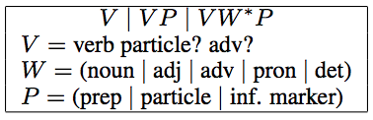
Web Crawling Framework
The 3M Company, formerly known as the Minnesota Mining and Manufacturing Company, is an American multinational conglomerate corporation operating in the fields of industry, health care, and consumer goods.^{[2]} The company produces a variety of products, including adhesives, abrasives, laminates, passive fire protection, personal protective equipment, dental and orthodontic products, electronic materials, medical products, car-care products,^{[3]} electronic circuits, healthcare software and optical films.^{[4]}
Query Formulator
Web Crawler
Parser
Web Resource Manager
Output
Refined
Query
List of
URLs
Raw
Texts
“3M”
Mandatory
~Minnesota ~Mining
~Manufacturing
Company
Name
Optionals
filetype:PDF
SEC
Source
URLs
…
Raw text
Master
Document
Information Classification & Aggregation
Profile Manager
Classifier
Positive
Feedback
CIK → SEC NAICS → SEC
SEC → CIK
Pfizer
URLs
3M
Wiki
Relevant Text Documents
The 3M Company, formerly known as the Minnesota Mining and Manufacturing Company
Output
Dole
Subsidiaries
Computational Fact-Checking using KGs
Triple Construction (Reverb)
Base Knowledge Graph
Tim Cook is heading Apple.
(Tim Cook,
heads,
Apple)

Slide 36


Open Information Extraction
Need to convert relevant text to structured data
Reverb gives use this capability using Natural Language Processing
A. Fader, S. Soderland, and O. Etzioni, Identifying relations for open information extraction, in Proceedings of the Conference on Empirical Methods in Natural Language Processing, EMNLP ’11, Stroudsburg, PA, USA, 2011, Association for Computational Linguistics, pp. 1535–1545.

Slide 37


Web Crawling Framework
The 3M Company, formerly known as the Minnesota Mining and Manufacturing Company, is an American multinational conglomerate corporation operating in the fields of industry, health care, and consumer goods.^{[2]} The company produces a variety of products, including adhesives, abrasives, laminates, passive fire protection, personal protective equipment, dental and orthodontic products, electronic materials, medical products, car-care products,^{[3]} electronic circuits, healthcare software and optical films.^{[4]}
Query Formulator
Web Crawler
Parser
Web Resource Manager
Output
Refined
Query
List of
URLs
Raw
Texts
“3M”
Mandatory
~Minnesota ~Mining
~Manufacturing
Company
Name
Optionals
filetype:PDF
SEC
Source
URLs
…
Raw text
Master
Document
Information Classification & Aggregation
Profile Manager
Classifier
Positive
Feedback
CIK → SEC NAICS → SEC
SEC → CIK
Pfizer
URLs
3M
Wiki
Relevant Text Documents
The 3M Company, formerly known as the Minnesota Mining and Manufacturing Company
Output
Dole
Subsidiaries
Positive Feedback
Computational Fact-Checking using KGs
Triple Construction (Reverb)
Computational Fact-Checking
Discarded facts
(Low Truth Value)
Facts to
be checked
Base Knowledge Graph
Tim Cooks is heading Apple.
(Tim Cook,
heads,
Apple)
(S,P,O)
Knowledge Graph Update with high truth value facts.

Slide 38

Knowledge Graphs
Notes:
Keyword generation for query formulation using word2vec.
In reality, because of how sporadic the information is and the inability to perform supervised learning, we have not found a need for query formulation yet.

Slide 39



Knowledge Linker
Is in
Valid facts should lie along specific paths
Westwood, Los Angeles, California, US
Is in
G. L. Ciampaglia, P. Shiralkar, L. M. Rocha, J. Bollen, F. Menczer, and A. Flammini, Computational fact checking from knowledge networks, PLOS ONE, 10 (2015).

Slide 40

Knowledge Stream
A "stream" (set of paths) provides more context than a single path
Relational similarity improves path specificity equation in Knowledge Linker
Ph.D.s
hires
work in
Institute of
Math
hosts
RIPS
works in
publishes
topic
Papers
P. Shiralkar, A. Flammini, F. Menczer, and G. L. Ciampaglia, Finding streams in knowledge graphs to support fact checking, CoRR, abs/1708.07239 (2017).

Slide 41
PredPath
UCLA
has major
Math
College
has major
Subject
B. Shi and T. Weninger, Fact checking in large knowledge graphs - A discriminative predicate path mining approach, CoRR, abs/1510.05911 (2015).

Slide 42
PredPath
Ph.D.s
work in
hires
C.S.
has major
CMU
has major
Finger
Painting
has
hobby
Students
B. Shi and T. Weninger, Fact checking in large knowledge graphs - A discriminative predicate path mining approach, CoRR, abs/1510.05911 (2015).

Slide 43
PredPath
Ph.D.s
Low Truth Value
work in
hires
Math
has major
UCLA
has major
Finger
Painting
has
hobby
High Truth Value
Students
B. Shi and T. Weninger, Fact checking in large knowledge graphs - A discriminative predicate path mining approach, CoRR, abs/1510.05911 (2015).

Slide 44
Towards a New Computational Fact-Checking Algorithm

Slide 45
Why both negative and positive samples?
UCLA
Positive Sample
Positive Sample
has Major
organizes
has Major
Math
Program in
Program in
Workshop
Anthropology
Program in
Robotics
has Major
organizes
has Major
CMU
Positive Sample
Negative Sample

Slide 46
StreamMiner, motivated by PredPath*
Built negative and positive feature sets
for training on graphs.
B. Shi and T. Weninger, Fact checking in large knowledge graphs - A discriminative predicate path mining approach, CoRR, abs/1510.05911 (2015).

Slide 47
Path Specificity
Path Specificity = Node Specificity + Path Similarity
How general the idea of the node is
(how many concepts are connected to it)
Very General: University
Very Specific: Conference Room, IPAM, UCLA
How similar two relations are
e.g.: Mentors
Highly Similar: advises, counsels
Less similar: robs, steals
Notes:
A general node which has

Slide 48

StreamMiner, motivated by KREL-LINKER*
Path Specificity = Node Specificity + Path Similarity
Logarithm of node in-degree
Relational similarity $w.r.t.$predicate P as cosine distance of co-occurrence
*P. Shiralkar, A. Flammini, F. Menczer, and G. L. Ciampaglia, Finding streams in knowledge graphs to support fact checking, CoRR, abs/1708.07239 (2017).

Slide 49





Path Specificity is more important than Path length
Place
$$u(P, \text{is} \text{a}\text{) = 1}$$
is a
$$u(P, \text{is} \text{a}\text{) = 1}$$
is a
is a?
UCLA
P =
University
Predicate in question
has athletic team
has a
$$u(P, \text{has} \text{athletic}$$
$$\text{team}\text{) = 0.1}$$
is a
$$u(P, \text{has} \text{a}\text{) = 0.6}$$
University Team
UCLA Bruins
$$u(P, \text{is} \text{a}\text{) = 1}$$

Slide 50
StreamMiner, motivated by Knowledge Stream*
Use of Transitive Closure on Dijkstra’s Algorithm with
Yen’s K-Shortest paths for mining path specificity instead of path length.
* P. Shiralkar, A. Flammini, F. Menczer, and G. L. Ciampaglia, Finding streams in knowledge graphs to support fact checking, CoRR, abs/1708.07239 (2017).

Slide 51
Stream Miner, Novel Fact Checking Algorithm
Motivated from PredPath
Use of positive and negative feature sets.
Motivated from
Knowledge Stream
Use of Transitive Closure on Dijkstra’s Algorithm with Yen’s K-Weighted Shortest paths for mining path specificity instead of path length.
Motivated from
K-REL-LINKER
Use of both node specificity and path similarity.

Slide 52
Stream Miner: Performance
Stream Miner was able to produce an average score of 86.325 (AUROC, Area under True Positive v/s False Positive Curve) on a sub-sample database in its first run,
which was at-par with the benchmark and state-of-the-art model PredPath.

Slide 53
Web Crawling Framework
The 3M Company, formerly known as the Minnesota Mining and Manufacturing Company, is an American multinational conglomerate corporation operating in the fields of industry, health care, and consumer goods.^{[2]} The company produces a variety of products, including adhesives, abrasives, laminates, passive fire protection, personal protective equipment, dental and orthodontic products, electronic materials, medical products, car-care products,^{[3]} electronic circuits, healthcare software and optical films.^{[4]}
Query Formulator
Web Crawler
Parser
Web Resource Manager
Output
Refined
Query
List of
URLs
Raw
Texts
“3M”
Mandatory
~Minnesota ~Mining
~Manufacturing
Company
Name
Optionals
filetype:PDF
SEC
Source
URLs
…
Raw text
Master
Document
Information Classification & Aggregation
Profile Manager
Classifier
Positive
Feedback
CIK → SEC NAICS → SEC
SEC → CIK
Pfizer
URLs
3M
Wiki
Relevant Text Documents
The 3M Company, formerly known as the Minnesota Mining and Manufacturing Company
Output
Dole
Subsidiaries
Positive Feedback
Computational Fact-Checking using KGs
Triple Construction (Reverb)
Computational Fact-Checking
Discarded facts
(Low Truth Value)
Facts to
be checked
Base Knowledge Graph
Tim Cooks is heading Apple.
(Tim Cook,
heads,
Apple)
(S,P,O)
Knowledge Graph Update with high truth value facts.

Slide 54
Web Crawling Framework
The 3M Company, formerly known as the Minnesota Mining and Manufacturing Company, is an American multinational conglomerate corporation operating in the fields of industry, health care, and consumer goods.^{[2]} The company produces a variety of products, including adhesives, abrasives, laminates, passive fire protection, personal protective equipment, dental and orthodontic products, electronic materials, medical products, car-care products,^{[3]} electronic circuits, healthcare software and optical films.^{[4]}
Query Formulator
Web Crawler
Parser
Web Resource Manager
Output
Refined
Query
List of
URLs
Raw
Texts
“3M”
Mandatory
~Minnesota ~Mining
~Manufacturing
Company
Name
Optionals
filetype:PDF
SEC
Source
URLs
…
Raw text
Master
Document
Information Classification & Aggregation
Profile Manager
Classifier
Positive
Feedback
CIK → SEC NAICS → SEC
SEC → CIK
Pfizer
URLs
3M
Wiki
Relevant Text Documents
The 3M Company, formerly known as the Minnesota Mining and Manufacturing Company
Output
Dole
Subsidiaries
Positive Feedback
Computational Fact-Checking using KGs
Triple Construction (Reverb)
Computational Fact-Checking
Discarded facts
(Low Truth Value)
Facts to
be checked
Base Knowledge Graph
Tim Cooks is heading Apple.
(Tim Cook,
heads,
Apple)
(S,P,O)
Knowledge Graph Update with high truth value facts.

Slide 55
Conclusion

Slide 56
Contributions
A web crawling, classification and fact-checking architecture.
A classification technique for retrieving relevant information.
A fact-checking algorithm, StreamMiner, for checking information credibility.

Slide 57
Contribution: Making Impact
Scaled up the Analysts' ability to retrieve information
Data of 52,000+ Companies for decision-making
Notes:
Praedicat, Inc. is an InsurTech that is doing ground-breaking work in risk-analysis by modeling the state and evolution of scientific literature to characterize the risk. Their goal is to make the world cleaner, safer, and healthier by identifying the emerging risk using the methodology based on the peer-reviewed scientific literature. By mining peer-reviewed science journals they are able to anticipate tomorrow's claims.

Slide 58










Acknowledgements
Shadi Shahsavari,
our academic mentor
Dr. Stephen DeSalvo,
Industry Mentor
Melissa Boudrea,
Industry Sponsor
Urjit Patel
Industry Mentor
Susana Serna,
our Program Director
David Medina,
Our IT Professional
Dimi Mavalski
Program Coordinator
Ronald McFarland
Program Co-ordinator

Slide 59
Questions?

